Slide 1
CZ1115
Mini Project
Group 6
Group Member:
ZOU ZE REN
CHUA ZI JIAN
LEE MING DA

Slide 2
01
02
TABLE OF CONTENTS
PROBLEM AND INTRO TO
DATASET
DATA CLEANING
AND VISUALISATION
03
04
DATA PROCESSING & MACHINE LEARNING
PREDICTING SYSTEM
Approaches used in cleaning the data and various visual grapths for presentation
List of data set used in the project
Justifying the predictors credibility
Prediting the criterials for the design system

Slide 3
01
Problem and Intro to
Dataset
List of data set used in the project

Slide 4

Problem Statement
No review rating or any comment after purchasing a product
Challenge for any ecommerce platform to perform If a company predicts whether a customer liked/disliked a product
Notes:
Most customers do not post a review rating or any comment after purchasing a product which is a challenge for any ecommerce platform to perform If a company predicts whether a customer liked/disliked a product so that they can recommend more similar and related products as well as they can decide whether or not a product should be sold at their end. This is crucial for ecommerce based company because they need to keep track of each product of each seller , so that none of products discourage their customers to come shop with them again. Moreover, if a specific product has very few rating and that too negetive, a company must not drop the product straight away, may be many customers who found the product to be useful haven't actually rated it.
Some reasons could possibly be comparing your product review with those of your competitors beforehand,gaining lots of insight about the product and saving a lot of manual data pre-processin,maintain good customer relationship with company,lend gifts, offers and deals if the company feels the customer is going to break the relation.
Objective of this case study is centered around predicting customer satisfaction with a product which can be deduced after predicting the product rating a user would rate after he makes a purchase.

Slide 5

Objective
Predicting customer satisfaction with a product after he makes a purchase.
Notes:
Objective of this case study is centered around predicting customer satisfaction with a product which can be deduced after predicting the product rating a user would rate after he makes a purchase.

Slide 6


Used DataSets
Analyse Olist E-Commerce dataset to predict order’s review
olist_customers_dataset
olist_geolocation_dataset
olist_order_items_dataset
olist_order_payments_dataset
olist_order_reviews_dataset
olist_orders_dataset
olist_products_dataset
olist_sellers_dataset
product_category_name_translation

Slide 7
02
Data Cleaning and visualisation

Slide 8
Data Cleaning
Visualisation Graph

Slide 9
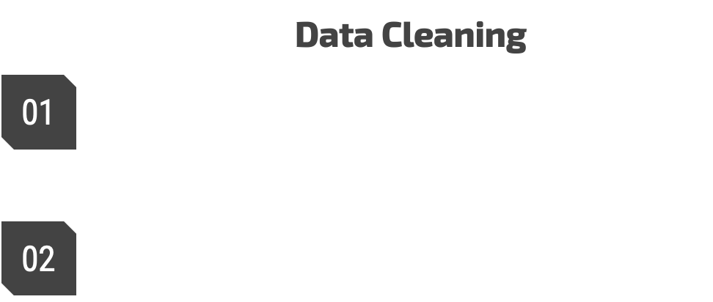

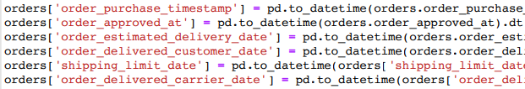
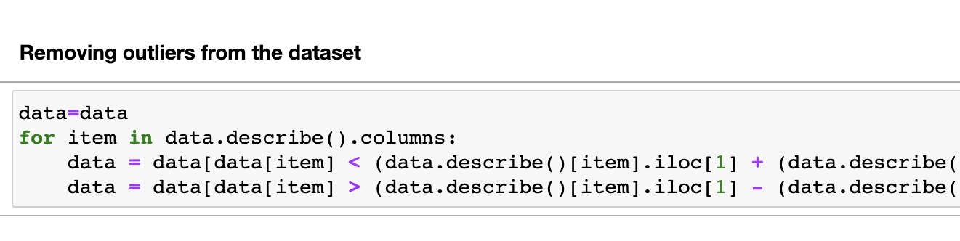
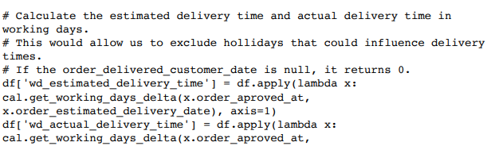
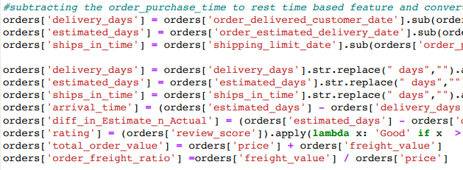
Data Cleaning

Slide 10
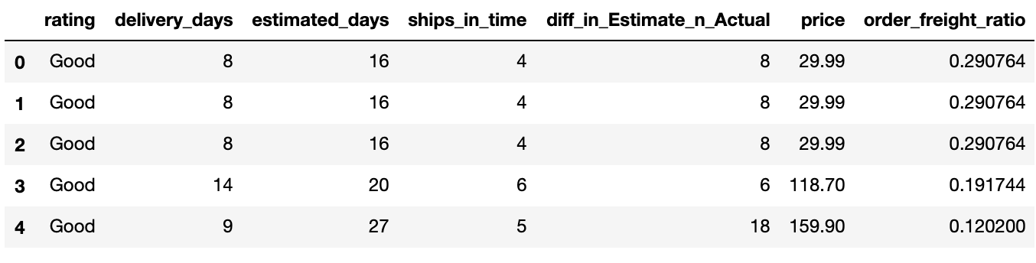
Cleaned Dataset

Slide 11
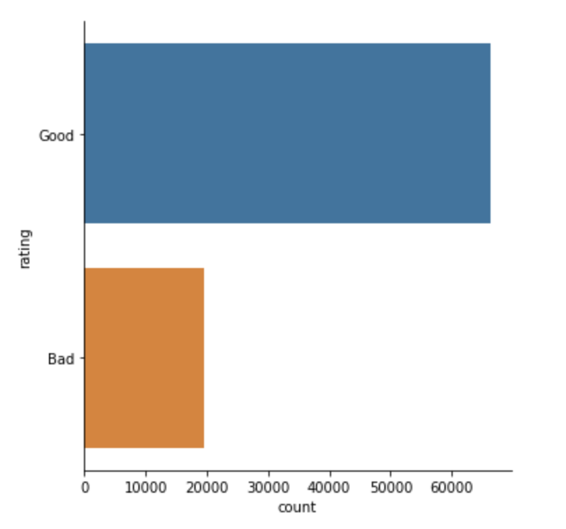
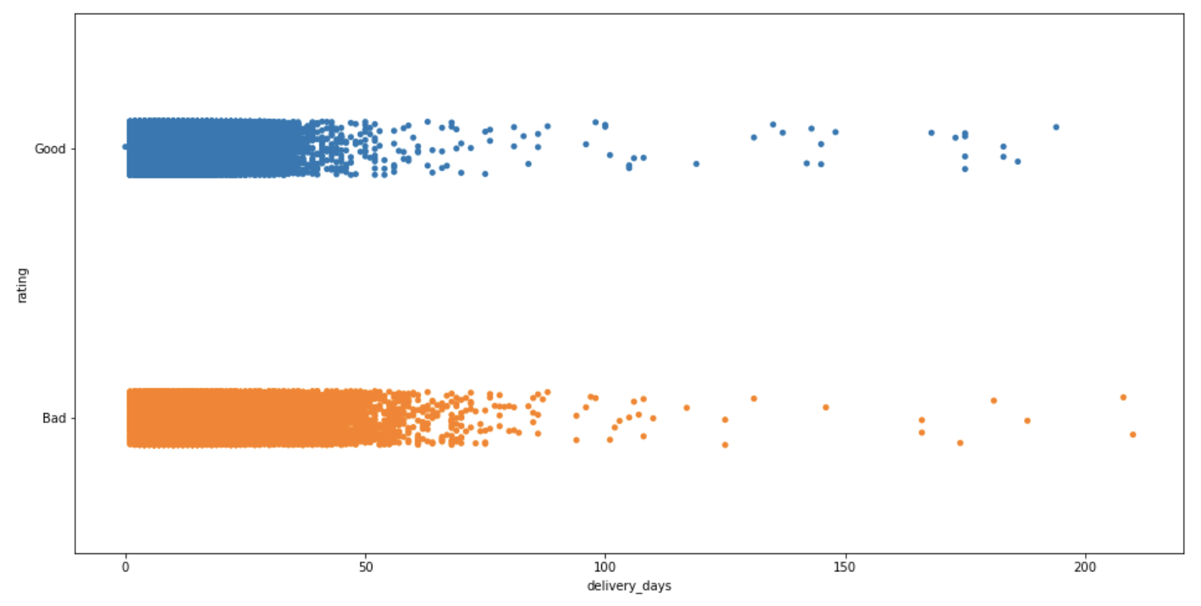
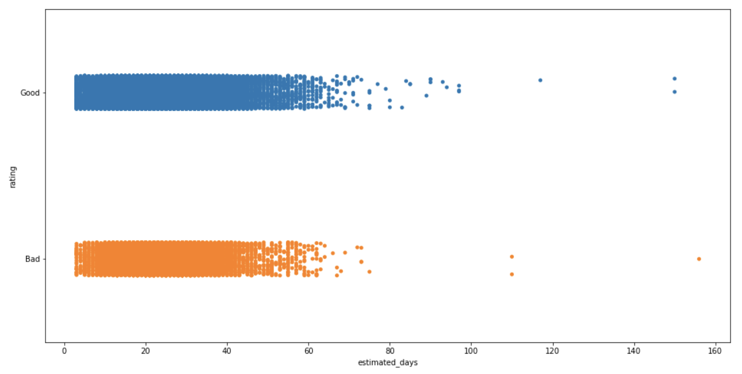
Visualisation Graph
Visualisation Graph
Rating Classified
Rating by Actual Delivery Days
Rating by Estimated Delivery Days

Slide 12
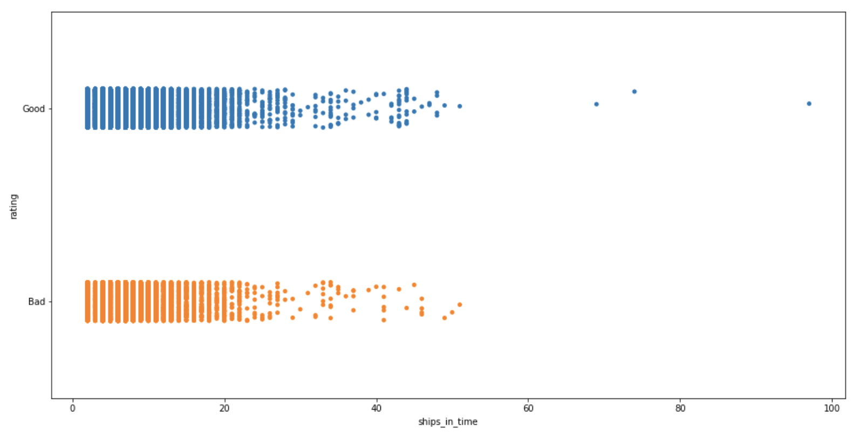
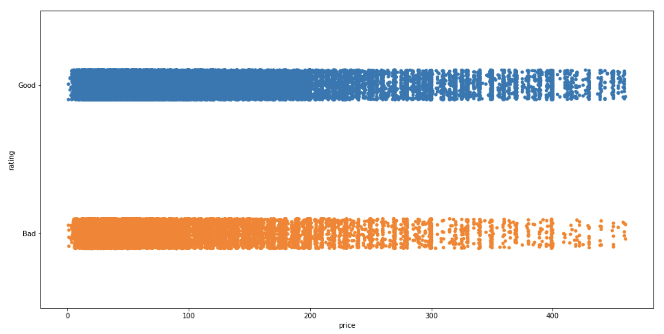
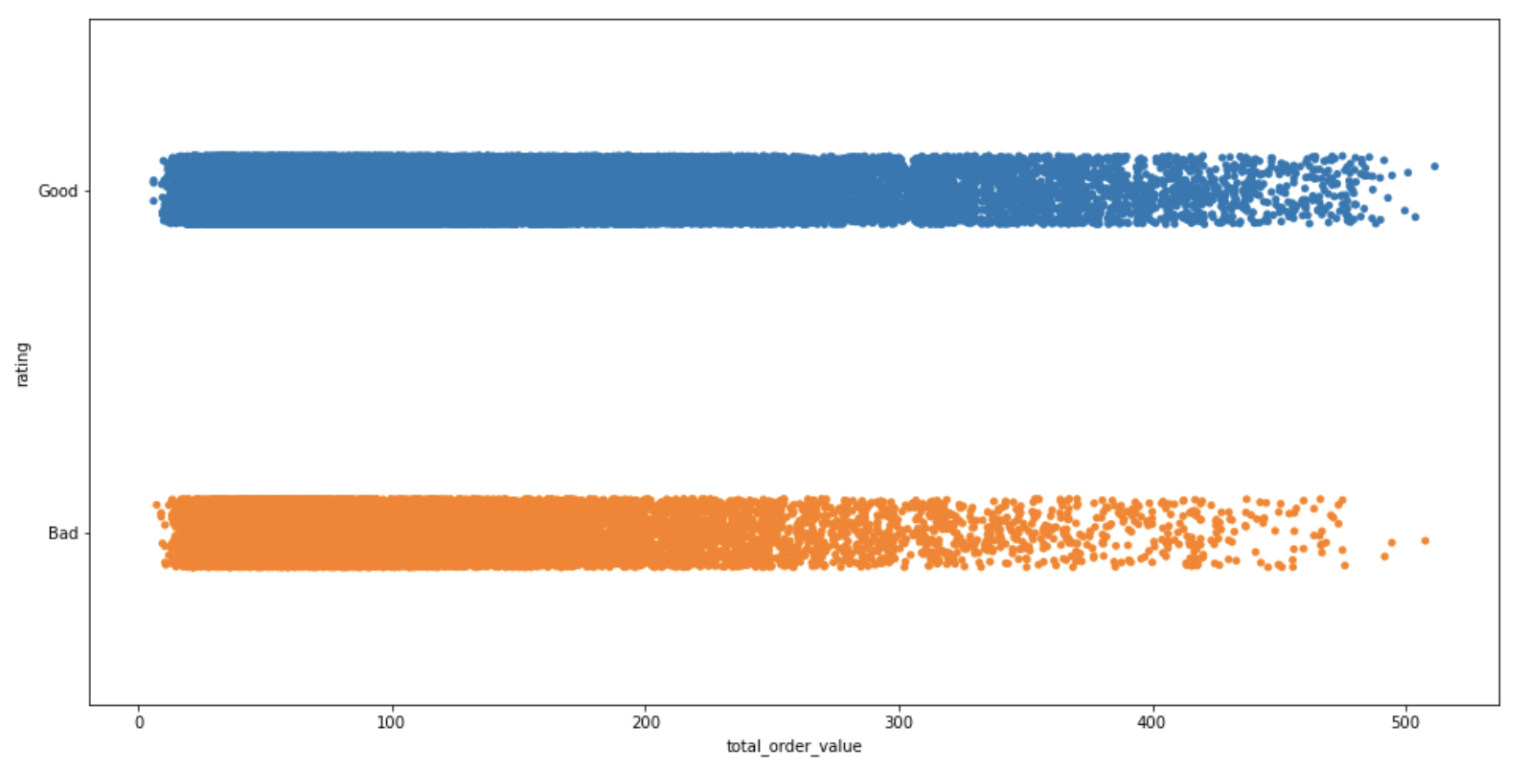
Visualisation Graph
Visualisation Graph
Ratings by Ship in time
Ratings by Price
Ratings by Total Order Value

Slide 13
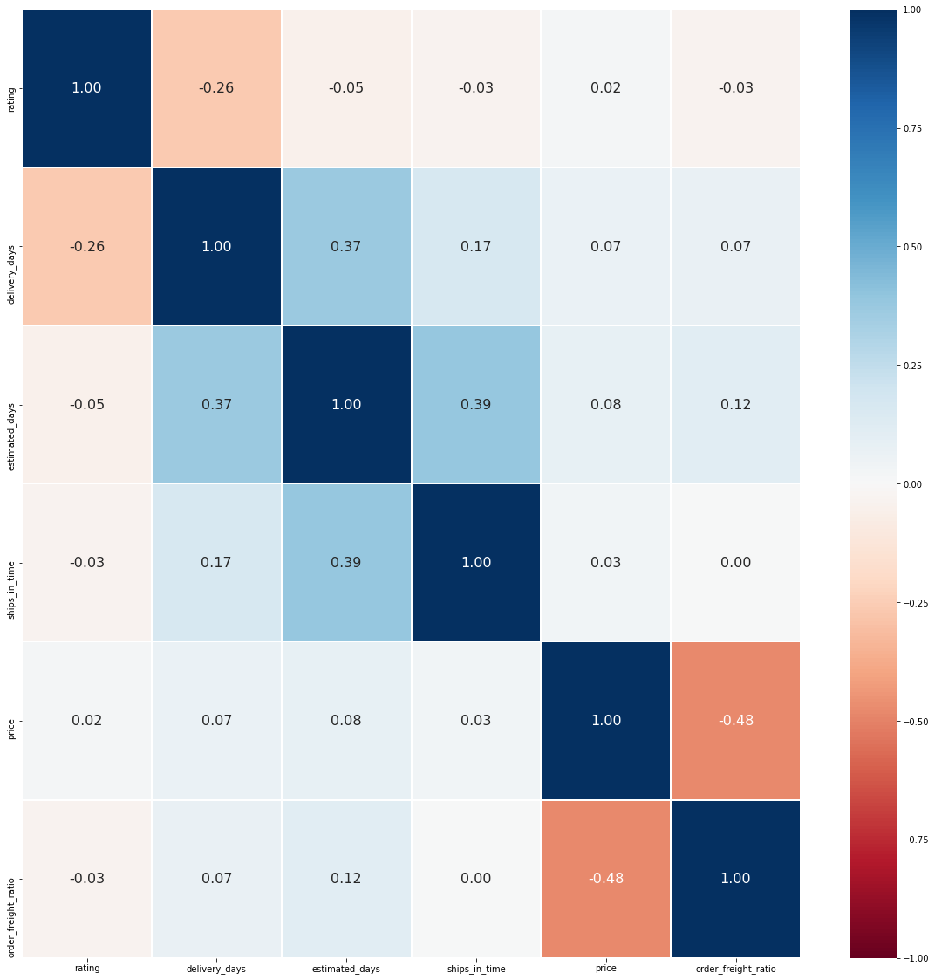
Multivariate correlation
Visualisation Graph
Predictors:
delivery_days, estimated_days, ships_in_time, price, order_freight_ratio

Slide 14
03
Machine Learning

Slide 15
ML
Machine Learning
Decision Tree Classification
Random Forest Classification
Naive Bayes Classification
Tuning parameters for tree classification using GridSearchCV
Notes:
in this project, we have decided to use this three model which is decision tree classification,random forest classification and the naive bayes classification, and tuning of the model by using grid search \\
ALL the model will be created using this five variable ,['delivery_days','estimated_days', 'ships_in_time', 'price',’order_freight ratio
And i am going to brief explain about what we had learnt.

Slide 16
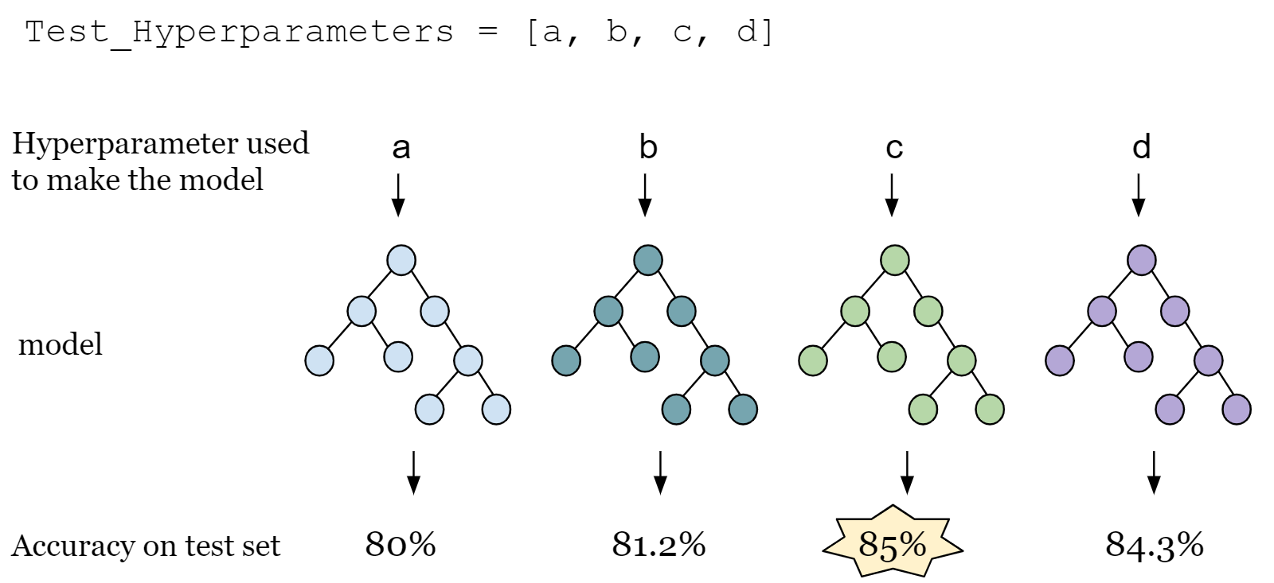
Grid Search
Machine Learning
Process of performing hyper parameter tuning in order to determine the optimal values for a given model.
Notes:
first of all,grid search.Grid search is the process of performing hyper parameter tuning in order to determine the optimal values for a given model.

Slide 17
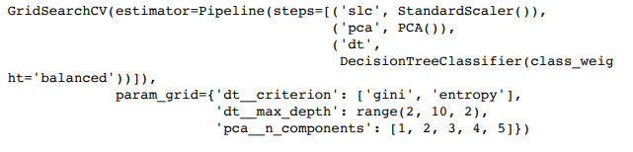
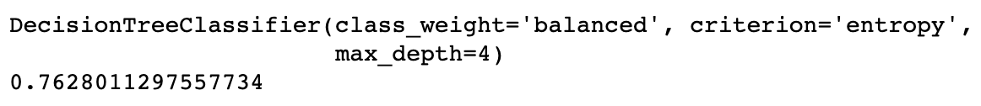
ML
Machine Learning
Method 1:Multi-Variate Decision Tree Classifier
Create an estimator to find the best model:
Use the Best Model found through GridSearchCV:
Notes:
And this is the optimum parameter of our first model, decision tree classifier we have found using grid search, the accuracy of the model is about 0.76 with the depth of 4

Slide 18
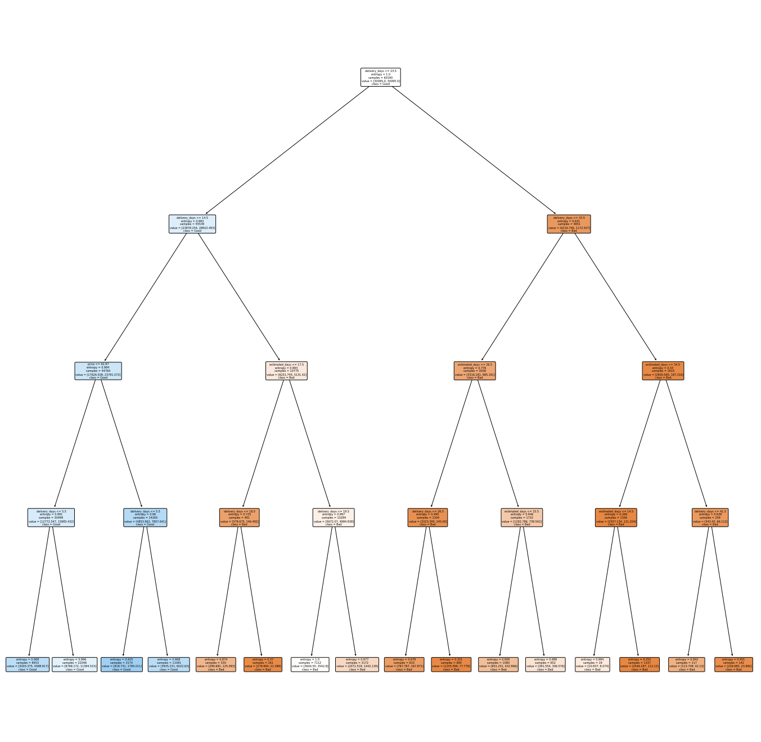
ML
Machine Learning
Decision Tree:
Notes:
Here is a picture of decision tree with depth of 4,this slides just show u roughly how it looks like,u can look into our notebook for more details

Slide 19
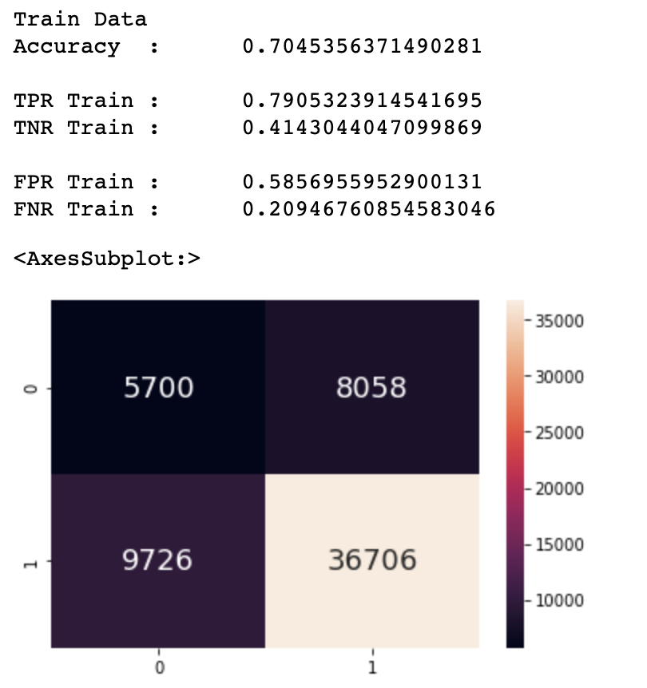
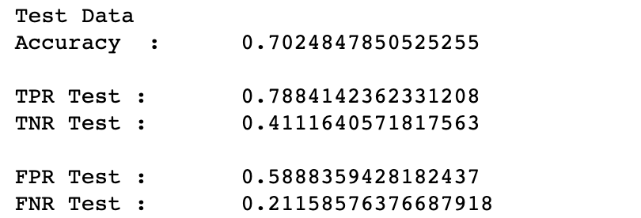
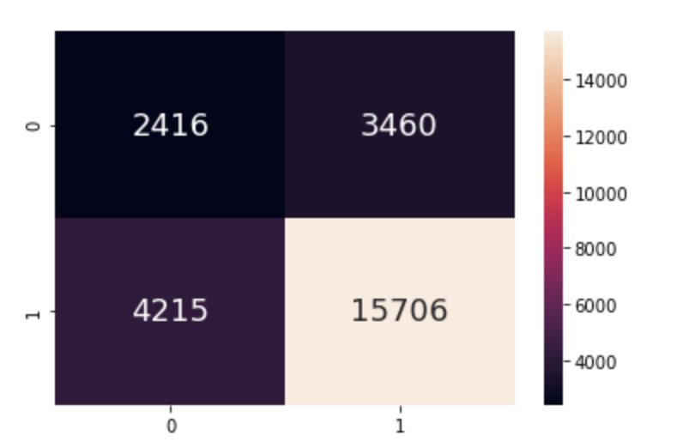
ML
Machine Learning
Method 1:Multi-Variate Decision Tree Classifier
Decision Tree Classifier has a high accuracy score, however it misclassify a high number of ‘Bad’ rating as ‘Good’
Notes:
this decision tree classifier model has an adequate accuracy and true positive rate,but its true negative rate is kind of low and the false positive rate is high so this is not a very good model.

Slide 20

ML
Machine Learning
Random Forest Classifier
A set of multiple decision trees.
Random forests prevents overfitting by creating trees on random subsets.
Random forests is difficult to interpret compared to a decision tree
Notes:
next is random forest
Random forests is basically a set of multiple decision trees.
Deep decision trees may suffer from overfitting, but random forests prevents overfitting by creating trees on random subsets.
Decision trees are computationally faster.
Random forests is difficult to interpret, while a decision tree is easily interpretable and can be converted to rules.

Slide 21
ML
Machine Learning
Method 2:Multi-Variate Random Forest Classifier
Use the best model found through GridSearchCV
Notes:
in this model ,we had found out that its optimal parameter is max depth of 10 and with 900 of n_estimator

Slide 22
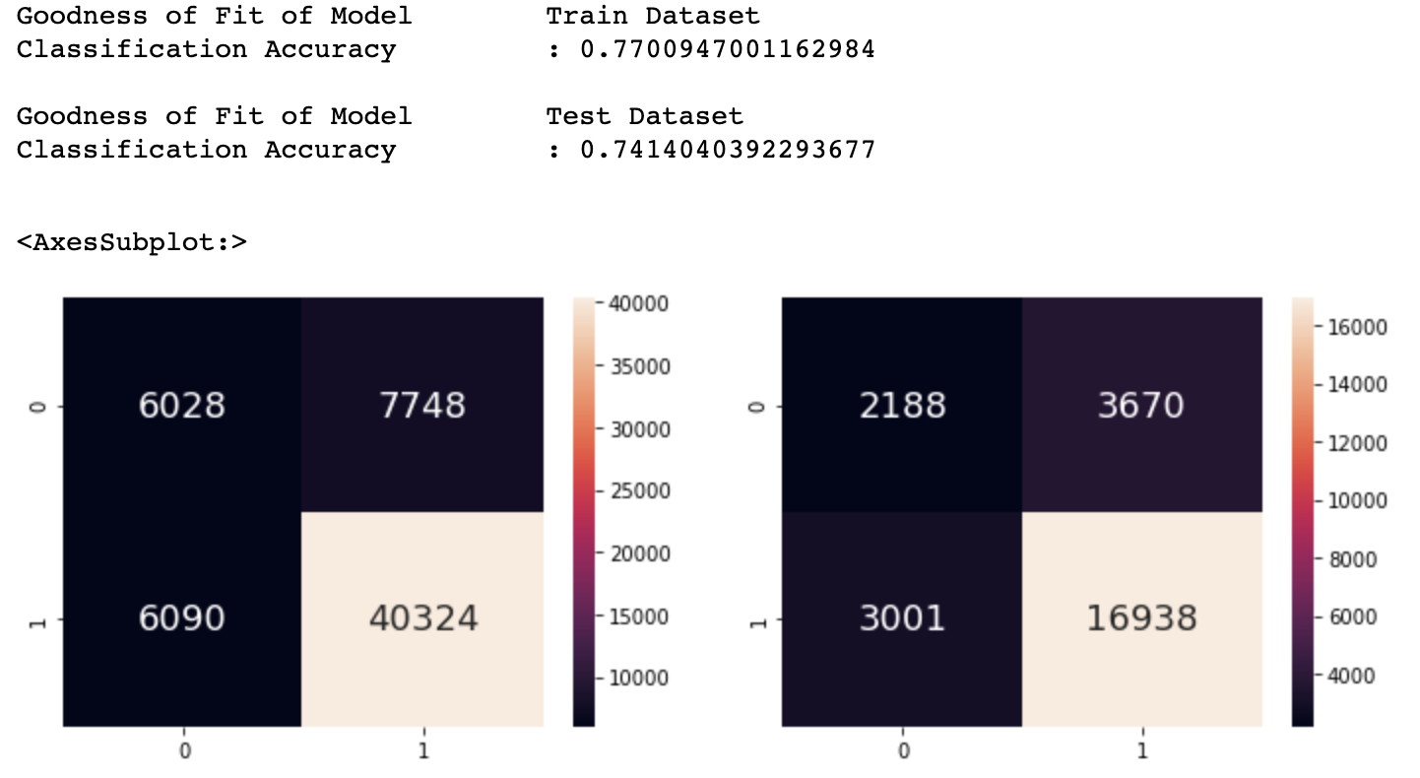
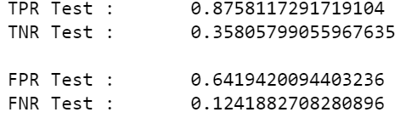
ML
Machine Learning
Method 2:Multi-Variate Random Forest Classifier
Random Forest Classifier has a high accuracy score, however both train and test cases have high false positive rate.
Notes:
the accuracy of random forest is a bit higher compared to the decision tree classifier we had seen just now.although the true positive rate is fairly higher than the decision tree model but its true negative rate is lower and its false positive rate is kind of high which show that this is not a very good model.

Slide 23
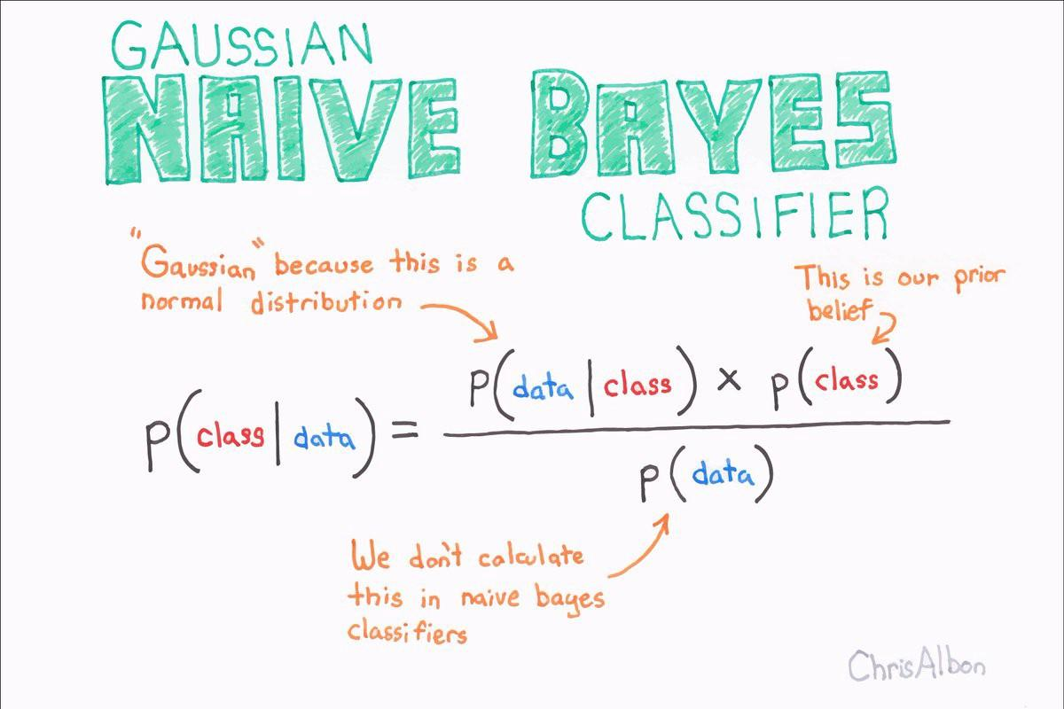
ML
Machine Learning
Naive Bayes Classfier
A classification technique based on Bayes’ Theorem with an assumption of independence among predictors.
Assumes that the presence of a particular feature in a class is unrelated to the presence of any other feature.
Notes:
and last but not least ,naive bayes,It is a classification technique based on Bayes’ Theorem with an assumption of independence among predictors. In simple terms, a Naive Bayes classifier assumes that the presence of a particular feature in a class is unrelated to the presence of any other feature.
Naive Bayes model is easy to build and particularly useful for very large data sets. Along with simplicity, Naive Bayes is known to outperform even highly sophisticated classification methods.

Slide 24
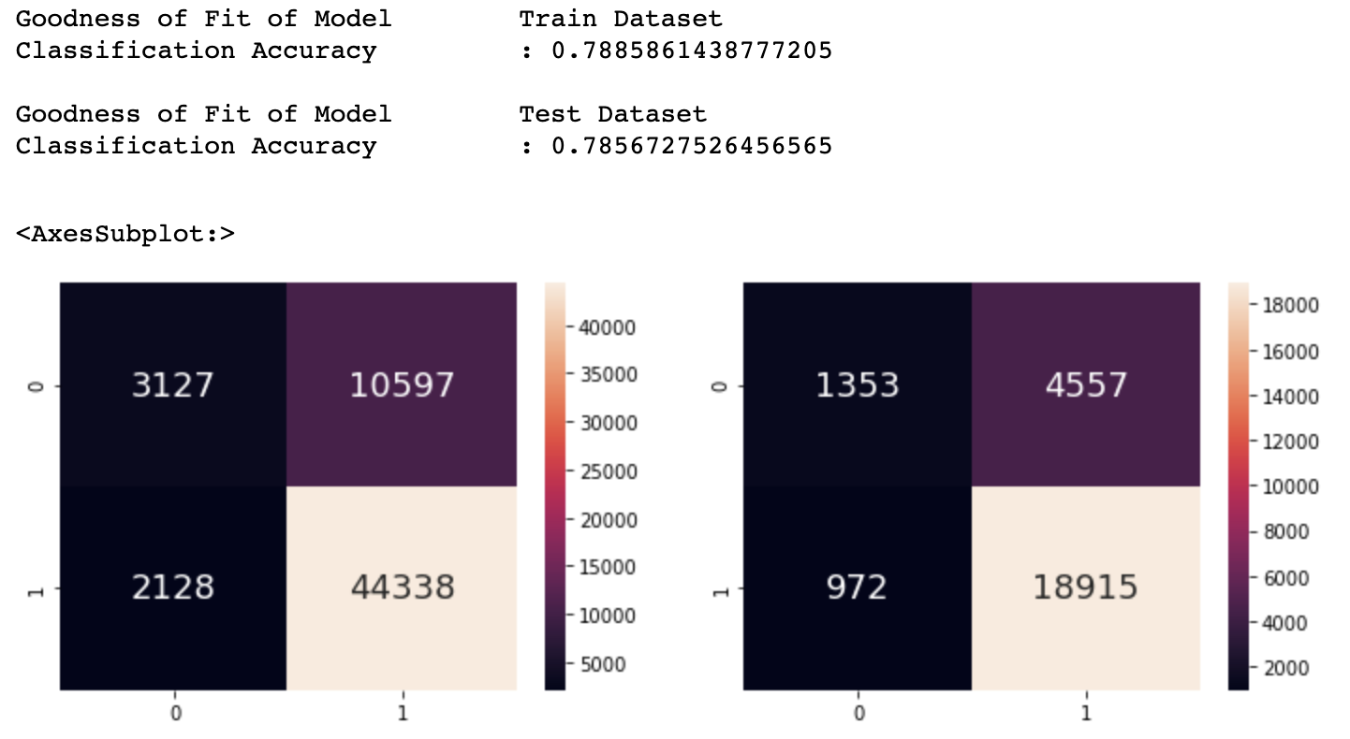
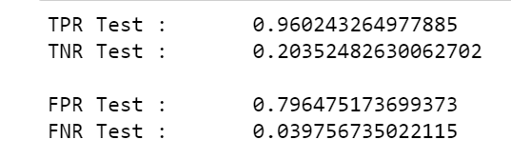
ML
Machine Learning
Method 3:Multi-Variate Naive Bayes Classifier
Naive Bayes Classifier has a high classification accuracy score, however it has the highest false positive rates for both it train and test cases.
Notes:
the accuracy of this model is almost the same as the random forest classifier.
it has the highest classification accuracy score among the three method, however it also has the highest false positive rates for both it train and test cases,which means that this is also not a suitable model for predicting rating.

Slide 25
04
Predicting System

Slide 26
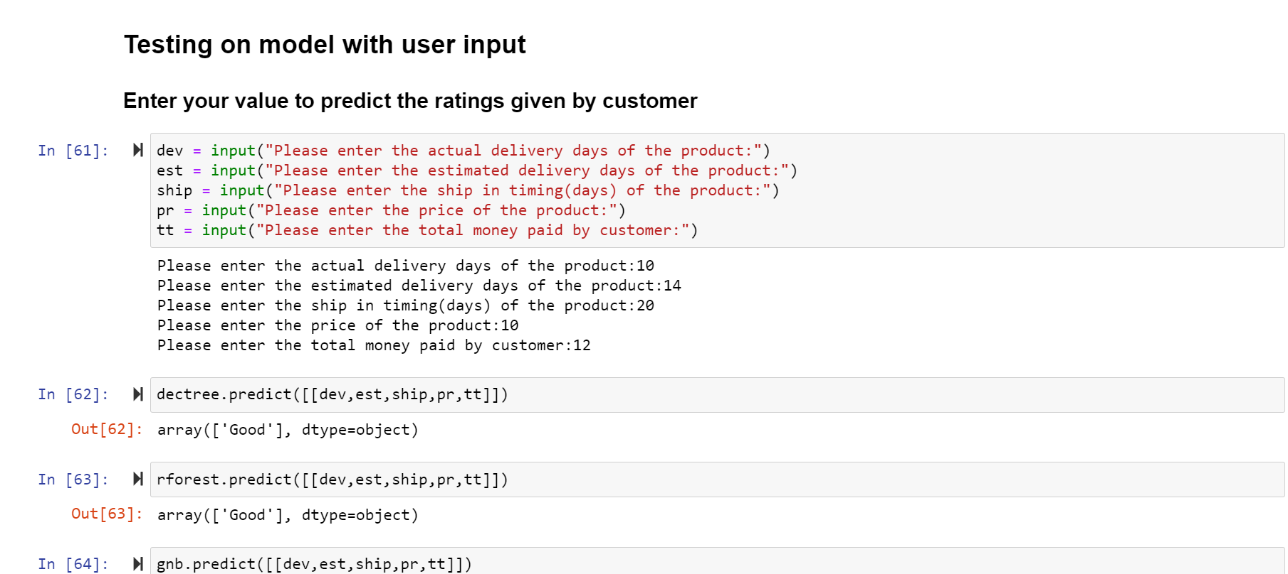
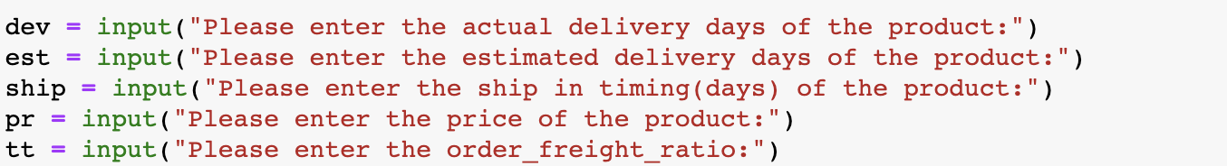


Slide 27
ML
Machine Learning
Outcome
Model is not useful for predicting ratings as there are high false positive rates.
Mainly due to imbalanced dataset, data is skewed to ‘good’ rating.
Notes:
Overall Random Forest perform better among the three mkdel in terms of all the performance metrics even though its false positive rates is abit higher than decision trees false positive rates
We found out that it is mainly due to imbalanced dataset, most of the data has ‘good’ rating. We swt class weights to balanced for all three model and it only shows a slight improvement in the false positive rates.
From the 3 methods we can conclude that Rating prediction is not really dependent directly on most of the features, so misclassification of false positive is high among all 3 of the machine learning mode.This contradict to our objective which is to let company predict customer satisfaction and companies may waste resources promoting an unpopular product
.

Slide 28
ML
Machine Learning
Work Done
Notes:
讲全部人一起做

Slide 29
Citation
https://www.analyticsvidhya.com/blog/2017/09/naive-bayes-explained/
https://scikit-learn.org/stable/modules/grid_search.html
https://www.datacamp.com/community/tutorials/random-forests-classifier-python\
https://medium.com/@jackstalfort/hyperparameter-tuning-using-grid-search-and-random-search-f8750a464b35
https://www.slideshare.net/palinanalytics/random-forest-classifier-in-machine-learning-palin-analytics
https://becominghuman.ai/naive-bayes-theorem-d8854a41ea08
https://www.pluralsight.com/guides/cleaning-up-data-from-outliers

